Slide 1
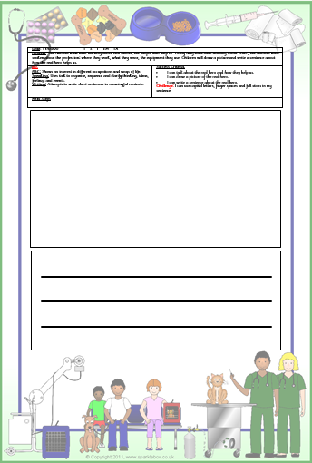
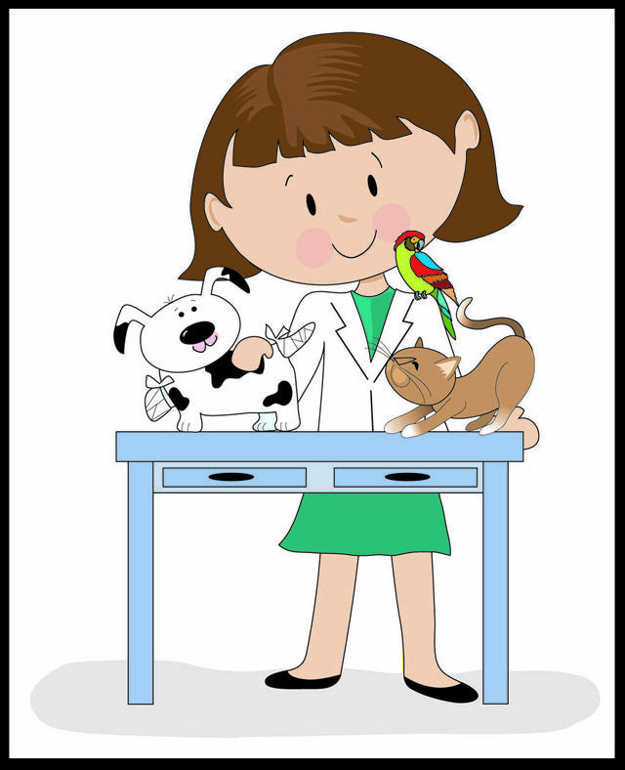
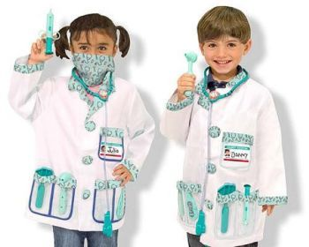
People who help us…. Vets
Watch the video:
https://www.youtube.com/watch?v=iQ6mc1NCylo
Optional writing home learning activity:
Draw a picture of a vet helping an animal.
Can you write a sentence about it?
Dress up as a Vet.
Can you help the animals get better?
I | no | go
to | the | into
Don’t forget to practice reading your read words. This will help you with your writing.

Slide 2
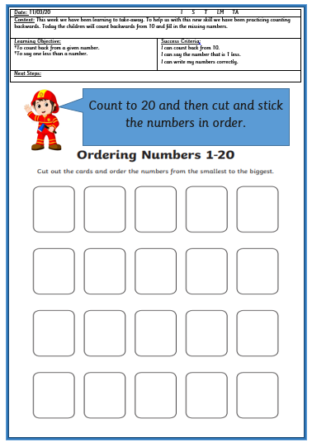
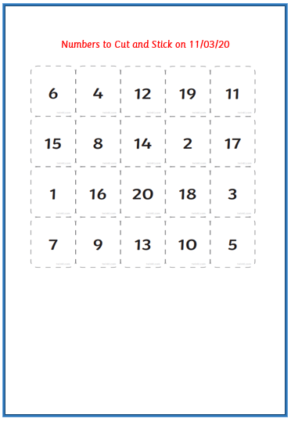
Optional maths activity in FS2 Home learning pack:
Cut the numbers 1 at a time and order them to 20.
Stick them in order on the Fireman’s sheet.
Maths Activity
Counting song with warm up actions:
https://www.youtube.com/watch?v=0TgLtF3PMOc
Can you fill say the numbers that are missing?

