Slide 1
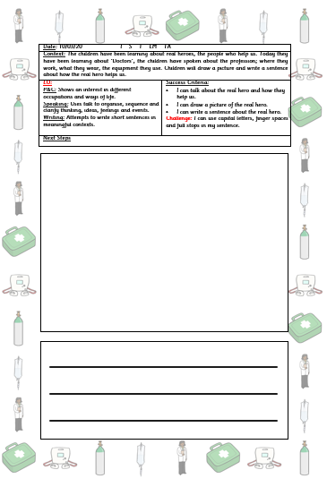
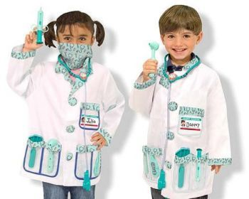
People who help us…. Doctors
Watch the video:
https://www.youtube.com/watch?v=JxdrEFz9Jsw
Optional writing home learning activity:
Draw a picture of a doctor helping someone.
Can you write a sentence about it?
Dress up as a doctor.
Can you help your patient get better?
I | no | go
to | the | into
Don’t forget to practice reading your read words. This will help you with your writing.

Slide 2
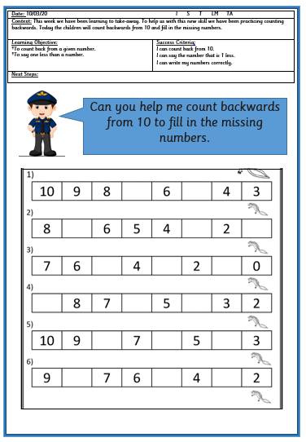
Maths Activity:
Listen to the song and encourage your child to sing along to it:
Optional maths activity in FS2 Home learning pack:
Count back from the first number and fill in the missing numbers.
https://www.youtube.com/watch?v=ShqXL-zfLxY

