Slide 1
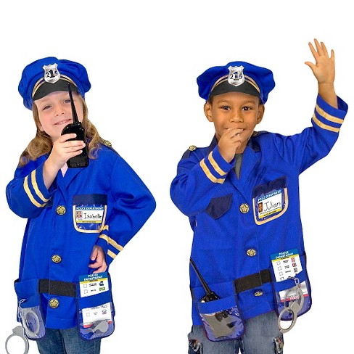
People who help us…. Police
Watch the video: https://www.youtube.com/watch?v=R-fOWq1-w4E
Optional writing home learning activity:
Draw a picture of a Police officer helping someone.
Can you write a sentence about it?
Dress up as a Police officer.
Can you help the people in your community?
I | no | go
to | the | into
Don’t forget to practice reading your read words. This will help you with your writing.

Slide 2
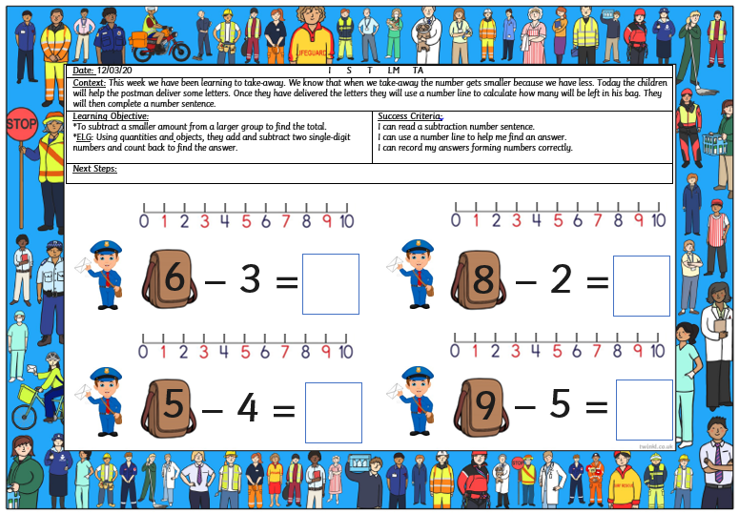
Maths Activity:
Listen to the song and encourage your child to sing along to it:
https://www.youtube.com/watch?v=0VLxWIHRD4E
Optional maths activity in FS2 Home learning pack:
Solve the take-away sums on the number line.
Please look at the example below to see how the children should do this.
Count the People Who Help us:
1.
2.
3.

