Slide 1
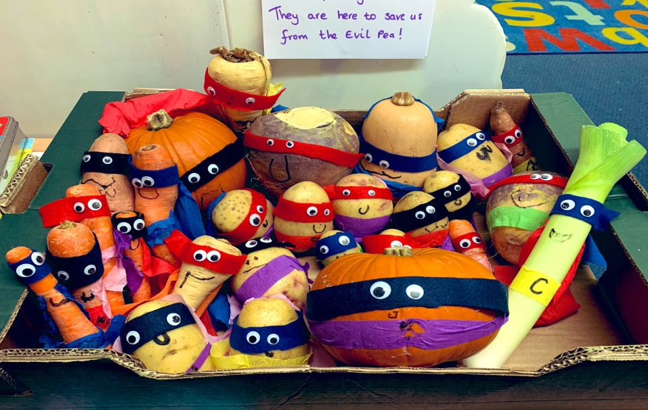
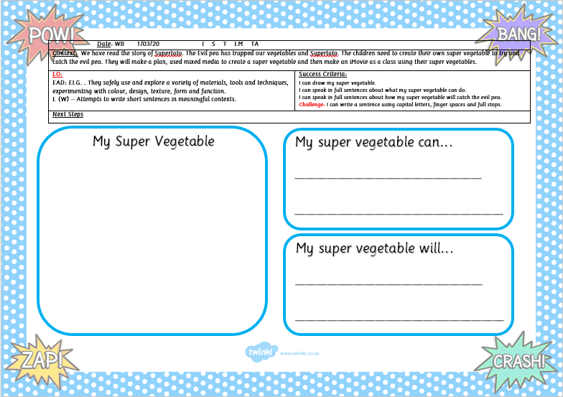
Supertato
Listen to the story here:
https://www.youtube.com/watch?v=rze89HB9u8g
Can you make your own Super vegetable?
Optional writing activity in FS2 Home learning pack:
Draw and colour your super vegetable
Write about your super vegetable

Slide 2
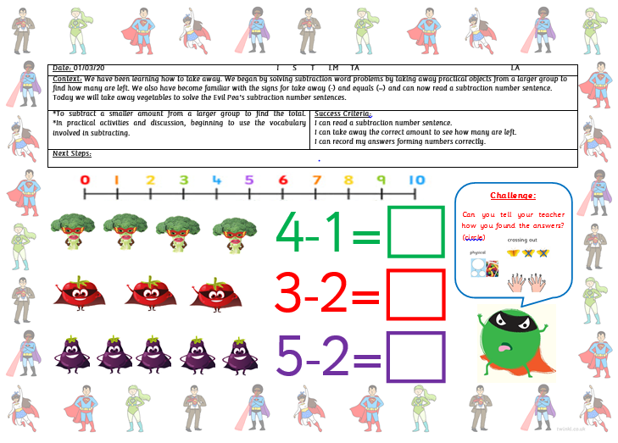
Maths Activity:
Listen to the song and encourage your child to sing along to it:
https://www.youtube.com/watch?v=ShqXL-zfLxY
Optional maths activity in FS2 Home learning pack:
Read the number sentence and solve the subtraction sums.
Write the answer in the box.
Do you have any vegetables in your home to count?

