Slide 1
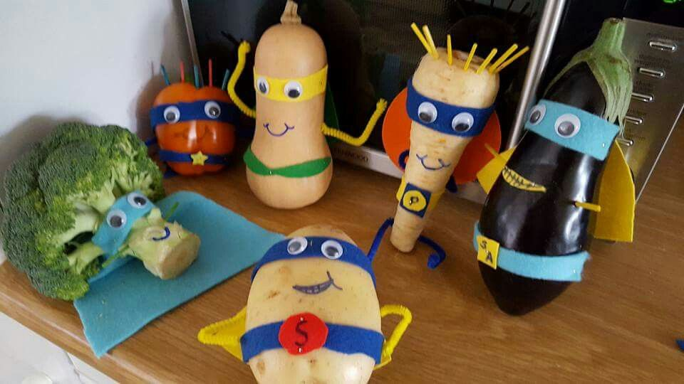
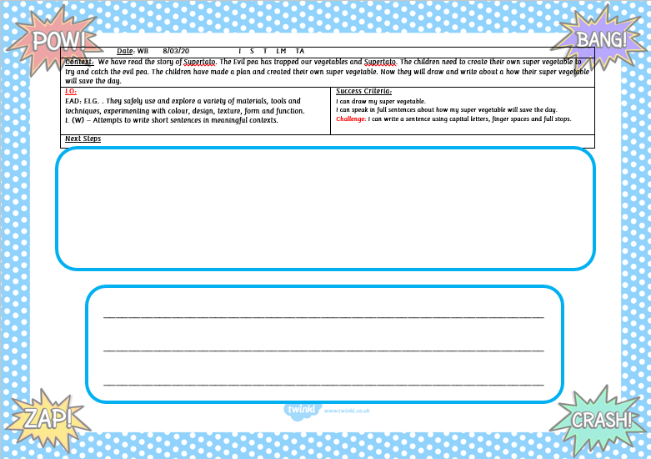
Supertato
Listen to the story here:
https://www.youtube.com/watch?v=rze89HB9u8g
Optional Home Learning
Draw and colour a picture of your super vegetable saving the other vegetables
Write about your drawing
Send a picture of your super vegetable to your class teacher!
Watch this movie, can you make your own movie?
https://www.youtube.com/watch?v=bBNV-YvdlO4

Slide 2
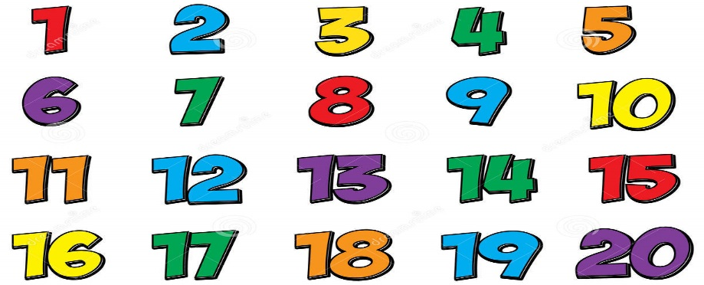
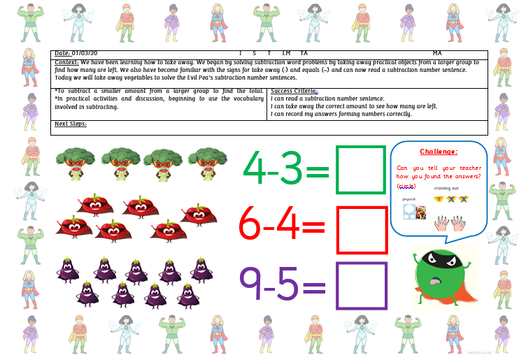
Maths Activity:
Listen to the song and encourage your child to sing along to it:
https://www.youtube.com/watch?v=0VLxWIHRD4E
Optional maths activity in FS2 Home learning pack:
Read the number sentence and solve the subtraction sums.
Write the answer in the box.
Count the vegetables and find the matching number:

